Slide 1
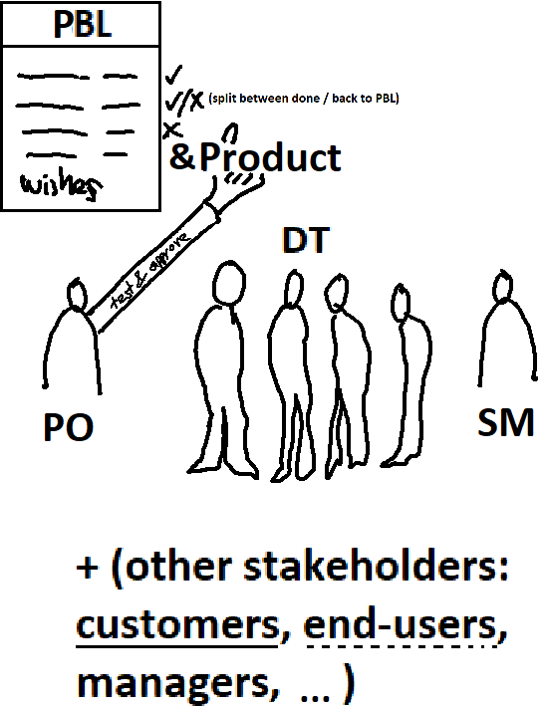
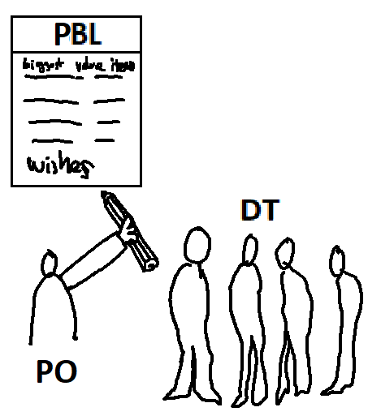
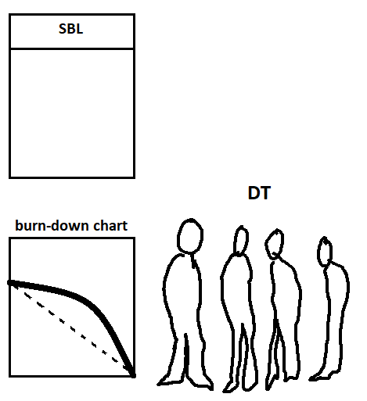
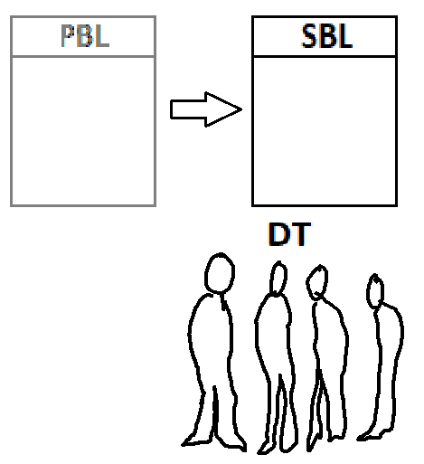
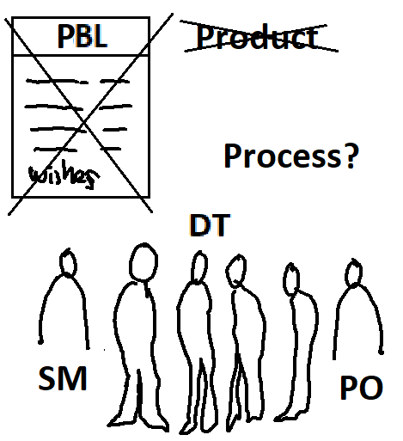
Meeting types in Scrum
SPM1 - refine/update PBL
- prioritize PBL items
“What?” - estimate effort 10-50h/PBLitem
- select PBL items for this Sprint
- (work on / estimate top items only)
“How?”
DSM/DS - What I did since last DSM?
- What I’ll do today? Pick task(s)
- Obstacles/Impediments?
- Sometimes called “standup meeting” because as short as possible. Max 2min / person. Total 5-15mins
- Burn-down chart shows remaining work
Sprint Review PO, DT, SM, (+cust, manag)
- Review the Product (& PBL items).
- PO might accept “Done” PBL items
- Incomplete work back to PBL, sometimes split into done and incomplete
- (Feedback and new direction)
late, but catching
“optimal”
SPM2 - Divide (some? first?) PBL items (selected for current Sprint) into “SBL” tasks = plan the work
- estimate efforts 2-6h
- prioritize / order (some tasks might have dependencies)
- (task lists are not going to be final. Tasks are updated all the time during the Sprint)
2000-2023 Juhani Välimäki
(Work) - (Workdays e.g. 8h long)
- (Minus lunch => 7.5h, minus coffee breaks =>7h)
- (Minus company trainings, company status meetings, communication, ICT problems, administration => ~6h a day)
- Use 6h in capacity calculations
- DT. PO must be “reachable"
Sprint Retrospective
- Process(es), co-op, values, communication, methods, efficiency, learning, tools, templates, …
- Improvements for the process for next Sprint

